Slide 1

UNDESIRED NATURAL LANGUAGE DETECTION
SRM INSTITUTE OF SCIENCE AND TECHNOLOGY
COLLEGE OF ENGINEERING AND TECHNOLOGY
DEPARTMENT OF COMPUTING TECHNOLOGIES
18CSP107L / 18CSP108L- MINOR PROJECT / INTERNSHIP
Mayank Sinha Reg No:RA1911003010386
Shivam Pandey Reg No:RA1911003010383
Guide name : Dr. G. Ramya

Slide 2
TABLE OF CONTENTS
INTRODUCTION
LITERATURE SURVEY
CHALLENGES TO ADDRESS
UML/BLOCK DIAGRAM
ALGORITHM USED
REFERENCES

Slide 3
INTRODUCTION
FREEDOM OF SPEECH ON THE INTERNET HAS LED TO A PERVASIVE PRESENCE OF UNDESIRED COMMENTS IN ONLINE DISCUSSIONS.
AN UNDESIRED COMMENT IS DEFINED AS A RUDE, DISRESPECTFUL, OR UNRESONABLE COMMENT THAT IS LIKELY TO MAKE OTHER USERS LEAVE A DISCUSSION.
THIS SOFTWARE WILL FACILITATE AND MAINTAIN THE OPENNESS OF THE ONLINE COMMUNITY.

Slide 4
LITERATURE REVIEW

Slide 5
AUTHOR | TITLE | SOURCE | FINDINGS
KAZI SAEED ALAM, SHIOVAN BHOWMIK | AN ENSEMBLE BASED MACHINE LEARNING APPROACH | RESEARCH GATE | USING ENSEMBLE BASED LEARNING FOR THE TEXT CLASSIFICATION.
DAROK ANDROCEC | MACHINE LEARNING METHODS FOR TOXIC COMMENT CLASSIFICATION | RESEARCH GATE | THERE ARE MULTIPLE CLASSES OF TOXICITY LIKE OBSCENE,THREAT,INSULT AND IDENTITY HATE ETC.
ANDAN KHALID, NUMAN SHAFI | A NOVEL PREPROCESSING TECHNIQUE FOR TOXIC COMMENT CLASSIFICATION | IEEE EXPLORE | THE REGEX EXPRESSION CAN BE USED FOR THE PREPROCESSING OF THE DATA.
ANIKET SULKE, AKASH VARUDE | CLASSIFICATION OF ONLINE PERNICIOUS COMMENTS USING MACHINE LEARNING | RESEARCH GATE | USAGE OF TF-IDF FOR THE FEATURE EXTRACTION FROM THE TRAINING DATA FOR THE COMMENT CLASSIFICATION.
PRASADHI RANASINGHE | CLASSIFICATION OF USEFUL COMMENTS IN STACK OVERFLOW | RESEARCH GATE | DETECTION OF USEFUL COMMENTS OF STACKOVERFLOW PLATFORM
ZHAO.Z, ZHANG Z | DETECTING TOXIC CONTENT ONLINE AND THE EFFECT OF TRAINING DATA ON CLASSIFICATION PERFORMANCE | THE UNIVERSITY OF SHEFFIELD | USING MULTIPLE DATA SROUCES FOR THE CREATION OF TRAINING DATA IS MUCH MORE BENEFICIAL FOR THE ACCURACY
P. VIDYULLATHA | IDENTIFICATION OF TOXIC COMMENTS USING MACHINE LEARNING | TURKISH JOURNAL OF COMPUTER AND MATHEMATICS EDUCATION | LEMMATIZATION OF WORD FOR THE GENERATION OF ROOT WORD
SARA ZAHERI | TOXIC COMMENT CLASSIFICATION | SOUTHERN METHODIST UNIVERSITY | MULTIPLE DEEP LEARNING ARCHITECTURE TO LEARN SEMANTIC EMBEDDING
MICHAEL AQUINO | TOXIC COMMENT DETECTION: ANALYZING THE COMBINATION OF TEXT AND EMOJI | IEEE EXPLORE | EMOJIS ALSO PLAY A ROLE IN THE CLASSICATION OF TOXIC TEXT

Slide 6
EXISTING METHOD AND DRAWBACKS

Slide 7
EXISTING METHOD | DRAWBACKS | IMPROVEMENT
TOXIC COMMENT DETECTION USING WORD MATCHING | SPELLING DETECTION | MACHINE LEARNING DETECTION
NATURAL LANGUAGE PROCESSING FOR INDIAN LANGUAGES | ONLY FOR INDIAN LANGUAGES | FOR ENGLISH LANGUAGE ALSO INCLUDED
DEEP LEARNING BASED TEXT CLASSIFICATION | SLOW IN IMPLEMENTATION | FASTER IMPLEMENTATION
DEEP CONVOLUTIONAL NETWORS FOR TEXT CALSSIFICATION | VERY COMPLEX DEEP LEARNING ALORITHM USED | SIMPLIFIED LINEAR CLASSIFICATION MODEL USED
UNSUPERVISED DATA AUGEMENTATION FOR CONSISTENCY TRAINING | UNSUPERVISED MODEL GAVE VERY LOW ACCURACY ON TEST DATA | SUPERVISED ALGORITHM GAVE MUCH BETTER RESULTS

Slide 8
CHALLENGES TO ADDRESS
Working with text data is always a challenge in it’s own because the cleaning of data is a tough job.
We need a huge pool of annotated data which is relevant to our problem statement.
Slang and sarcasm detection always pose a threat to the text detection algorithm.

Slide 9
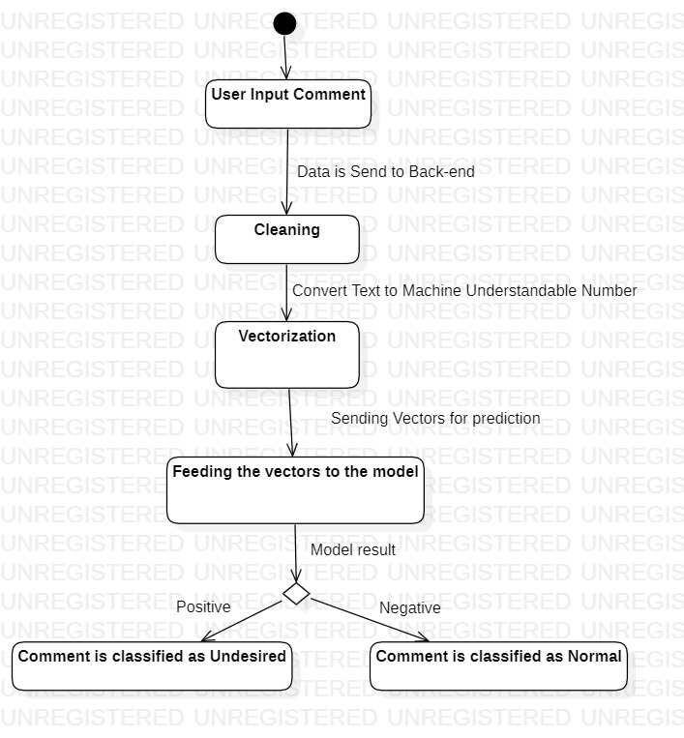
ACTIVITY DIAGRAM

Slide 10
ALGORITHM DIAGRAM
Supervised Machine Learning Models.
Ex. Logistic regression, Naïve Bayes, SVM etc.
STEPS:
Input
Data Cleaning of text data.
Vectorization
Model Training
Model Testing
Final Model selection
App development

Slide 11
REFERENCES
Toxic Comment Classification Sara Zaheri Southern Methodist University, szaheri@mail.smu.edu Jeff Leath Southern Methodist University, jleath@smu.edu David Stroud Southern Methodist University, jdstroud@smu.edu
Identification and Classification of Toxic Comment Using Machine Learning Methods P.Vidyullatha1 , Satya Narayan Padhy1 ,Javvaji Geetha Priya2 , Kakarlapudi Srija3 ,Sri Satyanjani Koppisetti4 1Associate Professor, Dept. of Computer Science and Engineering, Koneru Lakshmaiah Education Foundation, A.P.,, India
Zhao, Z., Zhang, Z. and Hopfgartner, F. orcid.org/0000-0003-0380-6088 (Submitted: 2019) Detecting toxic content online and the effect of training data on classification performance. EasyChair
Systematic Exploration and Classiﬁcation of Useful Comments in Stack Overﬂow Prasadhi Ranasinghe, Nipuni Chandimali, Chaman Wijesiriwardana Faculty of Information Technology University of Moratuwa Katubedda, Sri Lank
Classification of Online Pernicious Comments using Machine Learning Aniket L Sulke1 Akash S Varude2 1,2Researcher 1,2MIT Academy of Engineering, Pune, India
Machine learning methods for toxic comment classification: a systematic review Darko Androcec University of Zagreb
Cyberbullying Detection: An Ensemble Based Machine Learning Approach Kazi Saeed Alam Department of Computer Science and Engineering Khulna University of Engineering & Technology Khulna, Bangladesh saeed.alam@cse.kuet.ac.bd

Slide 12
THANK YOU

